Slide 1
BWSR Buffer Program Overview
Tom Gile| Buffers and Soil Loss Operations Supervisor
October 2018

Slide 2
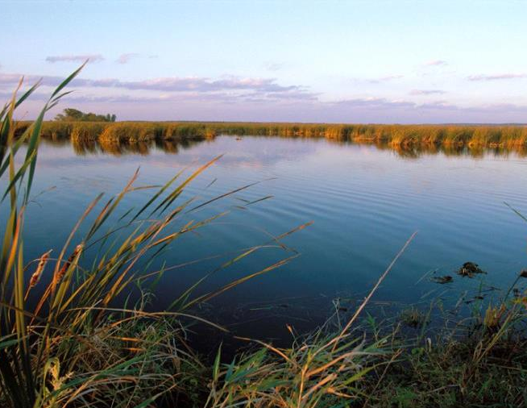
Improve and protect Minnesota’s water and soil resources by working in partnership with local organizations and private landowners.
Notes:
SCRIPT: Our mission is to Improve and protect Minnesota’s water and soil resources by working in partnership with local organizations and private landowners.

Slide 3
What & Where
50 foot average for public waters (30’ min)
As Identified on the Public Waters Inventory
(2016 amendment)
16.5 foot minimum for chapter 103E Public Drainage Systems
Perennial Vegetation (Does not prescribe Native Veg)

Slide 4
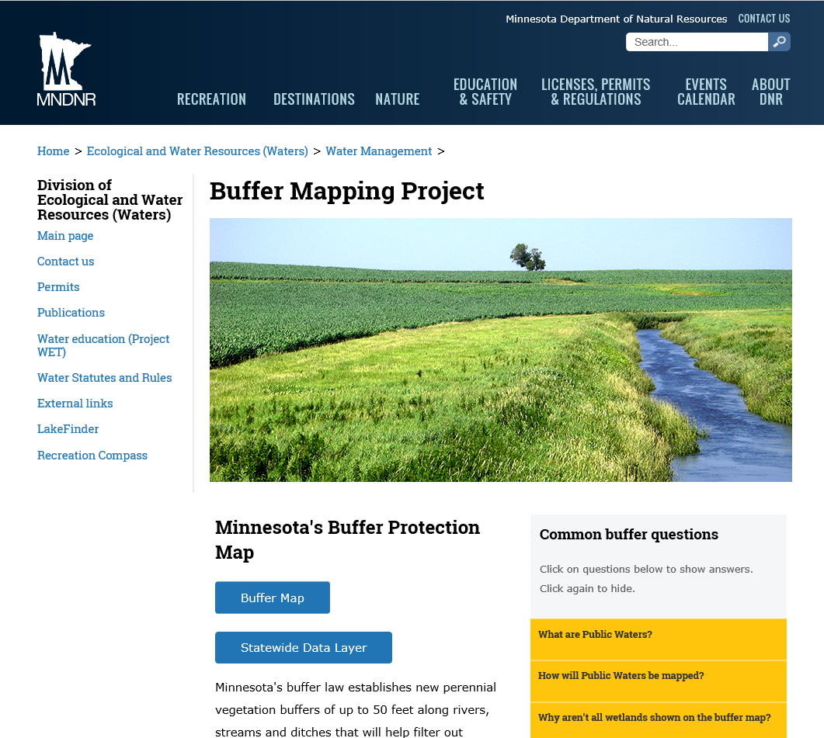
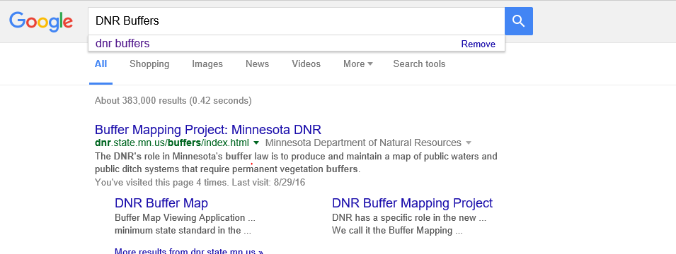
What & Where

Slide 5
Challenges

Slide 6
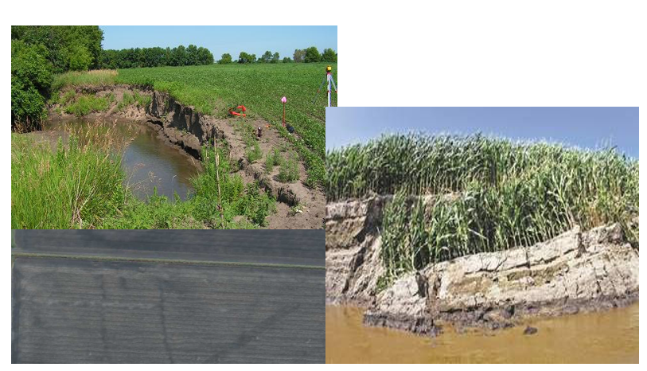
Challenges

Slide 7
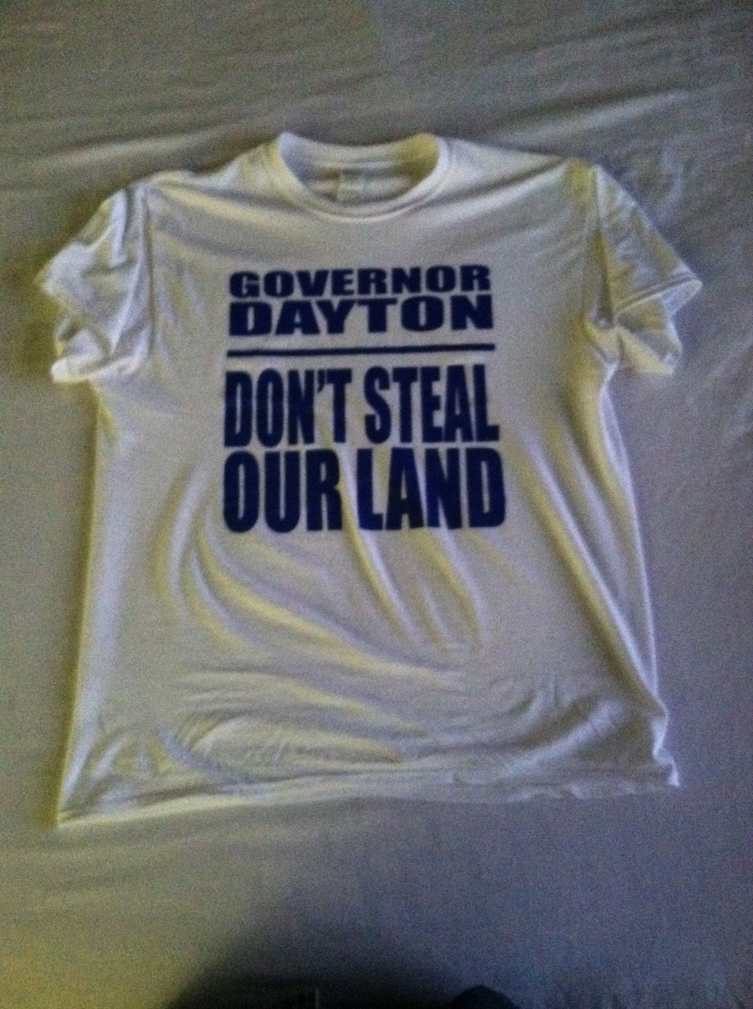
Challenges

Slide 8
Challenges

Slide 9
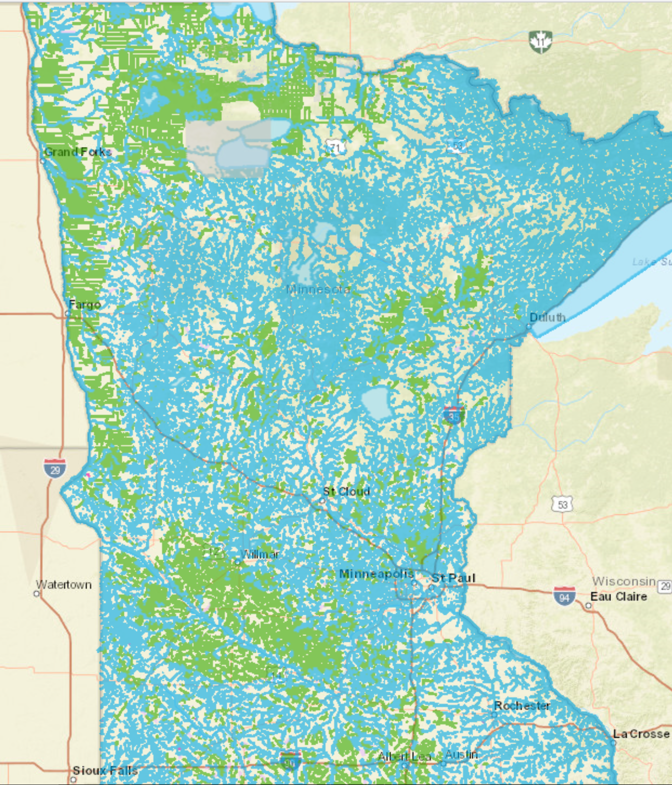
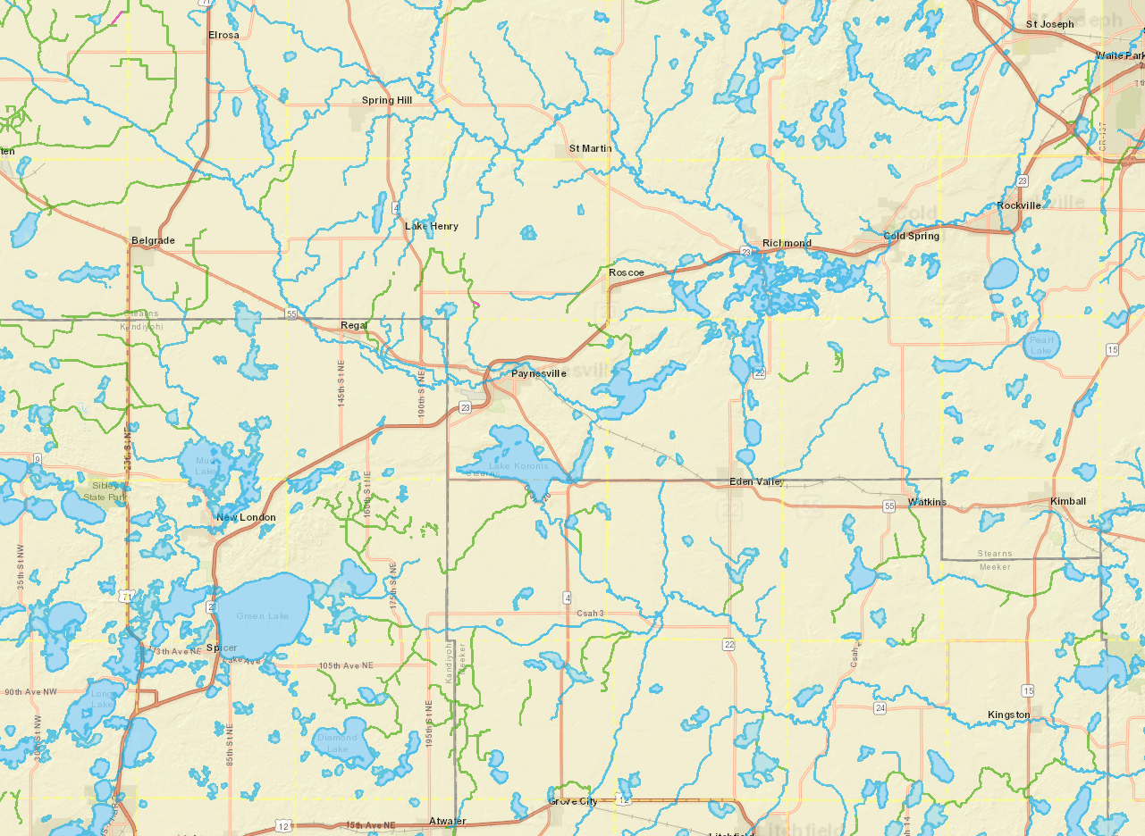
Challenges

Slide 10
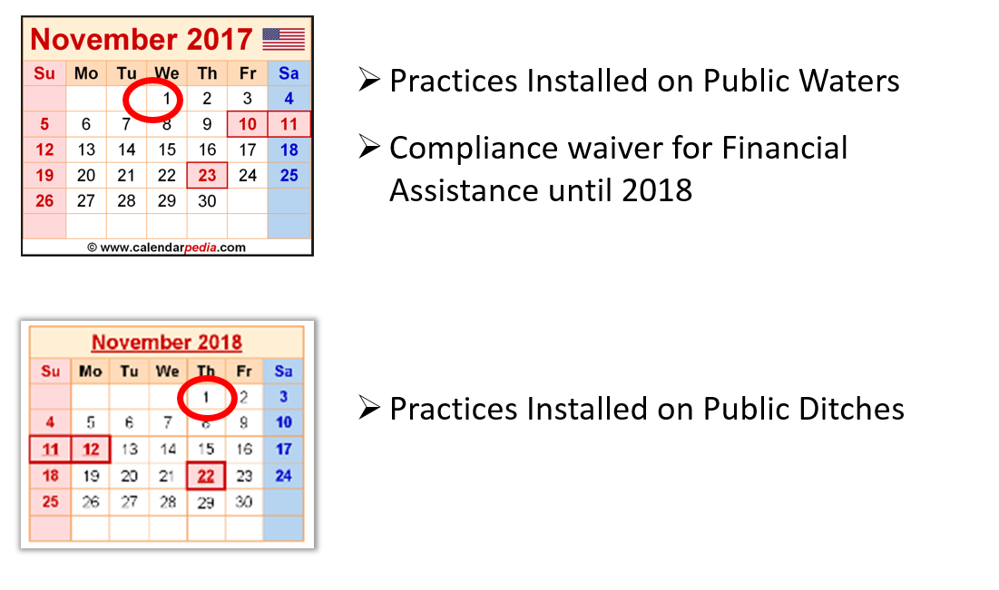
Challenges

Slide 11
Success

Slide 12
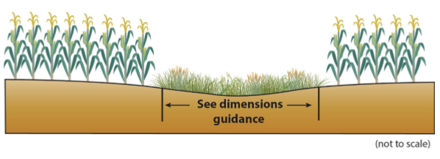
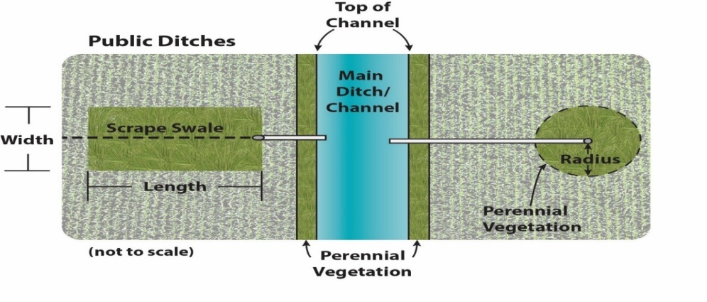
Success
Construction of the “6-pack” of Common Alternative Practices:
1. Minnesota Agricultural Water Quality
Certification Program
2. USDA-FOTG Practice Standards Filter Strip (393/391)
3. Grassed Waterway/Cultivated Watercourses
4. Negative slopes or concentrated inflow - public ditches
5. Negative slopes or concentrated inflow – public waters
6. Conservation Tillage/Cover Crops with Vegetated Filter Strip

Slide 13
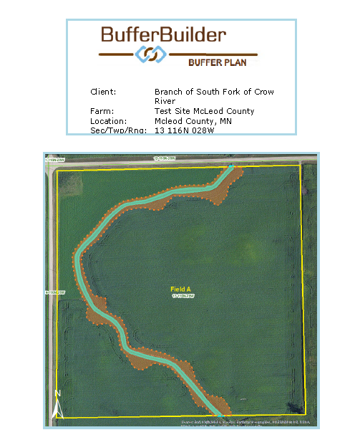
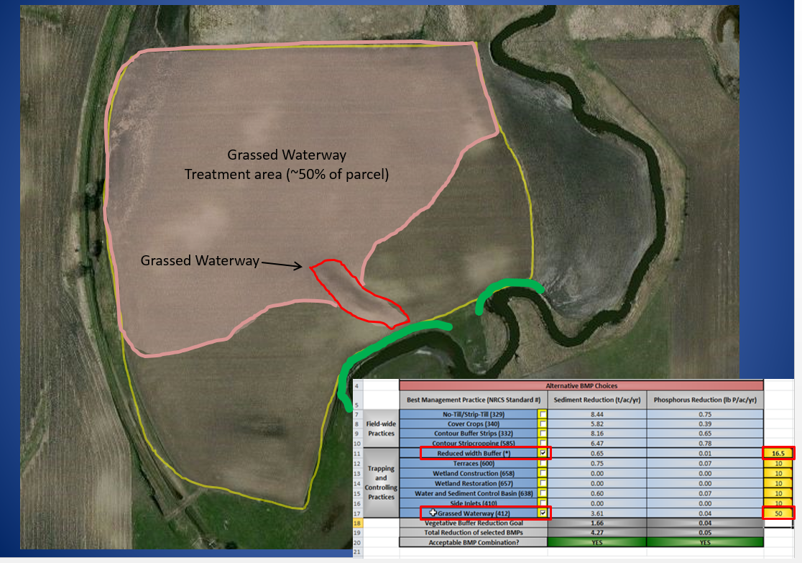
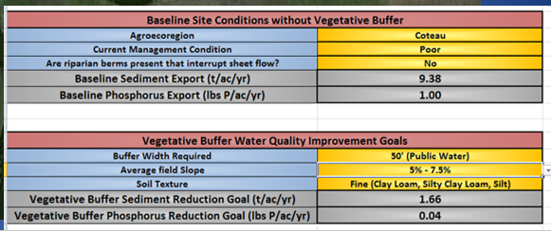
Success
U of MN & MN Corn Growers.
Alternative Practice Decision Support Tool

Slide 14
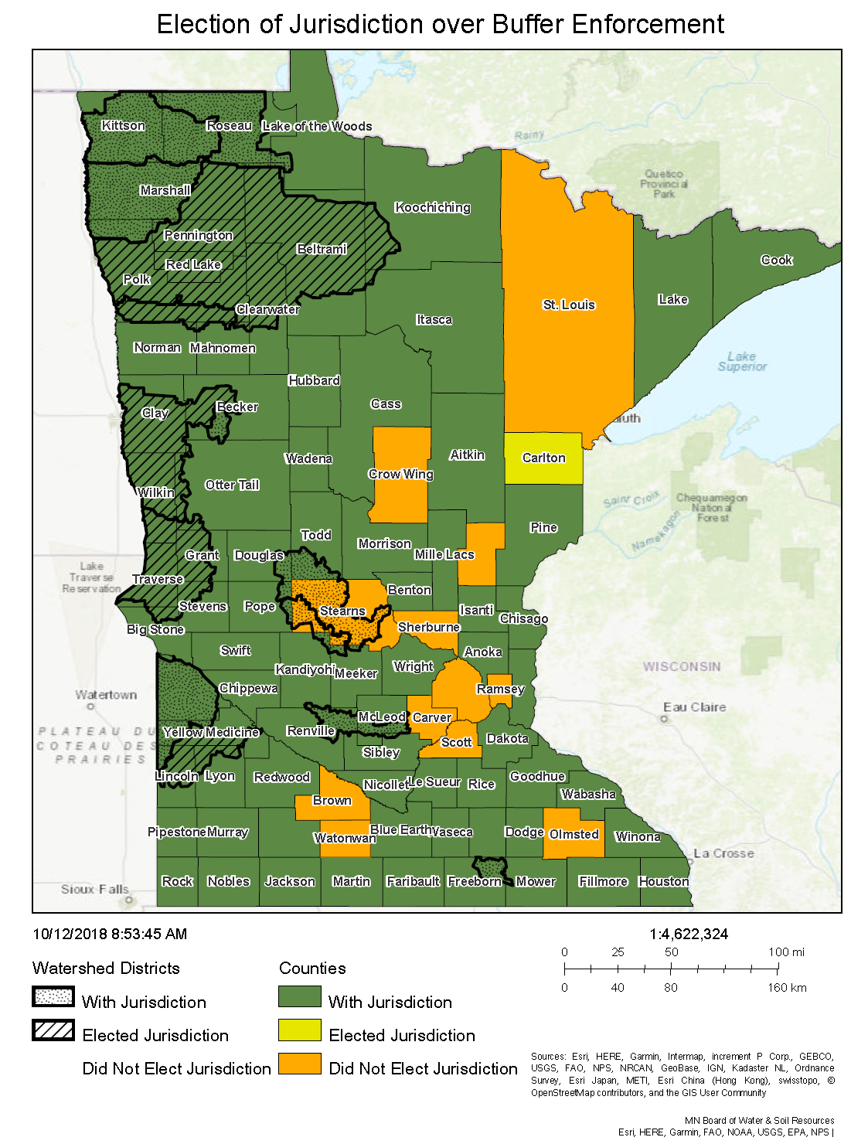
Success
75 Counties Elected.
All have submitted for preliminary reviews
74 have been adopted & are “with Jurisdiction”
1 pending “with jurisdiction”
14 Watersheds Elected
9 have been adopted & are “with Jurisdiction”
1 Under preliminary draft review
4 Awaiting Board Action and Hearings

Slide 15
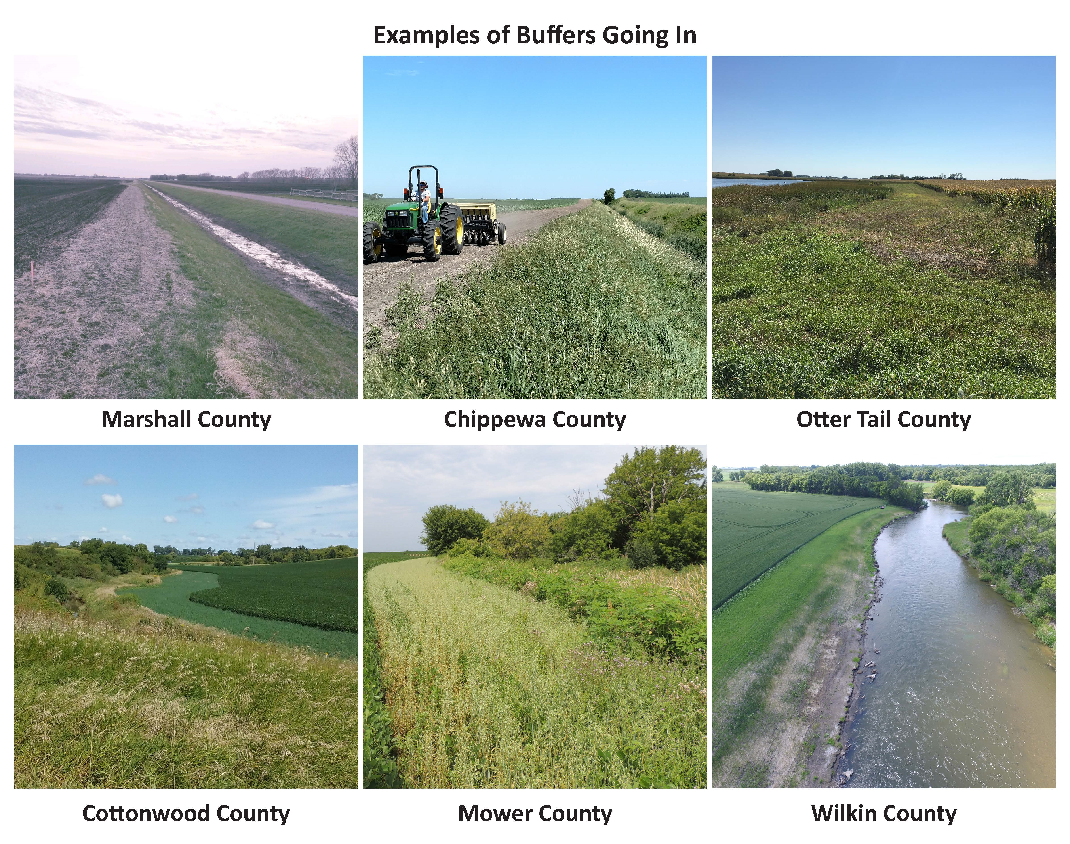
Success

Slide 16
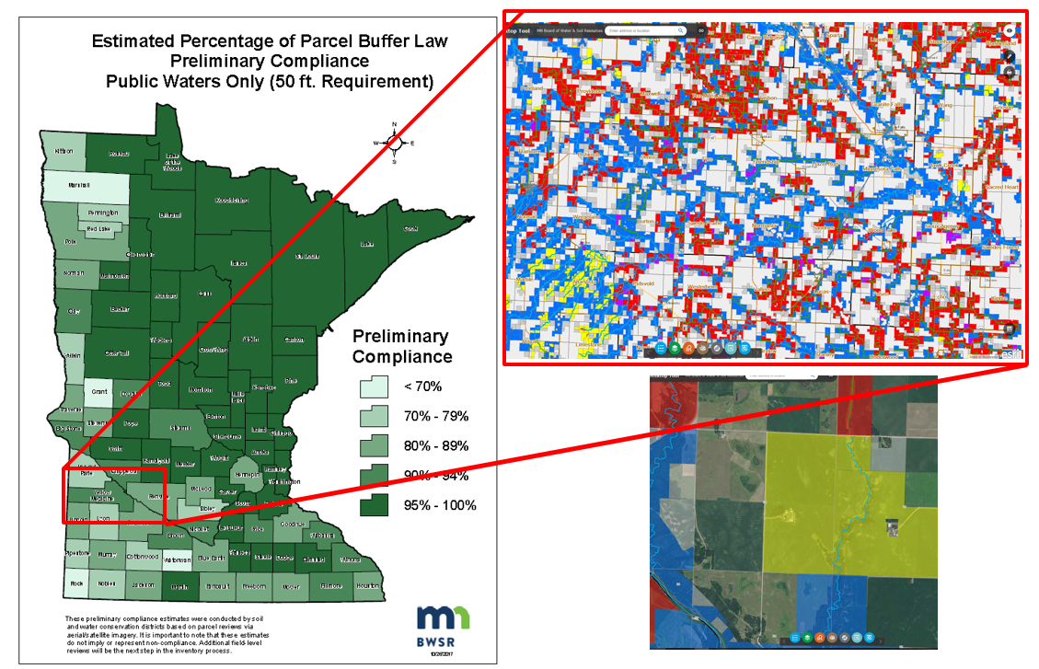
Success

Slide 17
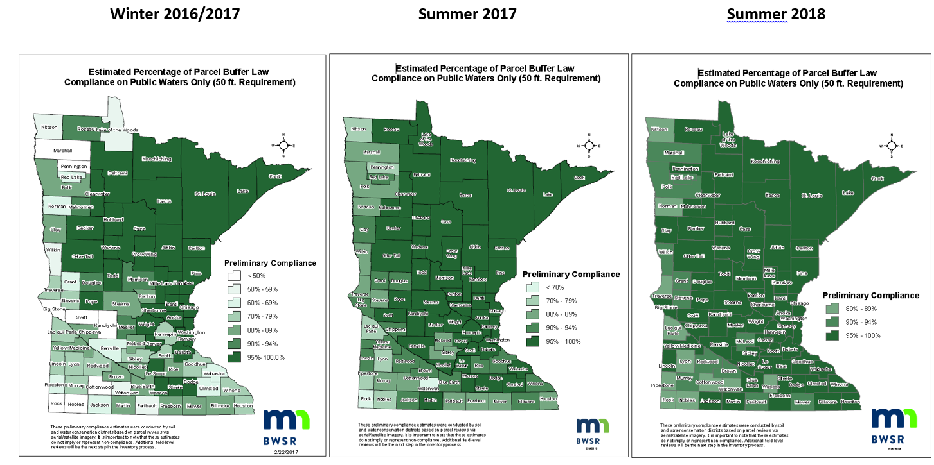
Success

Slide 18
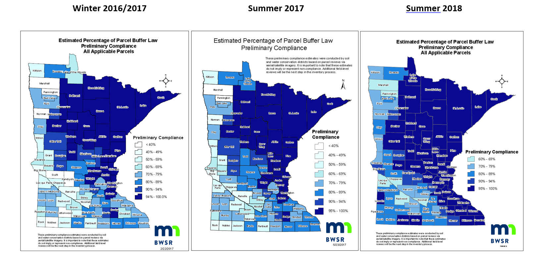
Success

Slide 19
Minnesota’s Buffer Law
http://bwsr.state.mn.us/buffers/

